Slide 1

Hackathon project Auto-Pdf
Team abcd
Table 298
Atharva sapre
Shivam saraswat

Slide 2
The need
Pdf creators are being used by everyone nowadays, be it a student or engineer.
During this Corona situation pdf scanners are especially being used by students of all age to submit their homeworks, projects and sometimes even tests.
We have tried multiple android apps for this purpose yet found none satisfactory.
As a result we thought of creating one such app specifically to meet various features we found lacking in all the apps we tried.

Slide 3
Features...more coming soon
Black and white
Manual and Auto-Crop

Slide 4
Upcoming features
Annotations
Text Add
Auto Rotation
Space efficient

Slide 5
Auto-crop
Auto-crop is the price jewel of our project.
There is a special code just for this feature
Made using image processing
Totally custom built

Slide 6
coding
Coding has mostly been done in Python
The android app will be made in Flutter

Slide 7
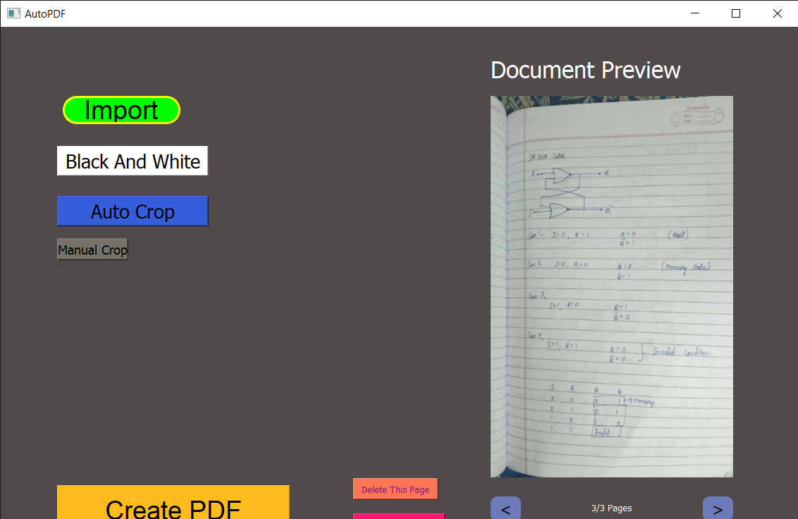
screenshots

Slide 8
Thank You

